Slide 1
Constructing bar charts by utilising technology
Graphical representations of data

Slide 2
how to use Oak lessons

Slide 3
I can construct bar charts from data using technology.

Slide 4
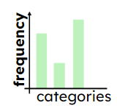
The frequency is the number of times an event occurs; or the number of individuals (people, animals etc.) with some specific property.
A bar chart (bar graph) is a graph consisting of bars visually representing the frequency of objects or groups.
Data are a collection of information.

Slide 5

Constructing bar charts by utilising technology
Creating bar charts on spreadsheet software
Creating bar charts using a template file

Slide 6
Creating bar charts on spreadsheet software
There are many different spreadsheet software available.
Two of the most common are
Microsoft Excel
Google Sheets
Their functionality and appearance are fairly similar.
Find out which spreadsheet software you have access to and open a new spreadsheet.

Slide 7
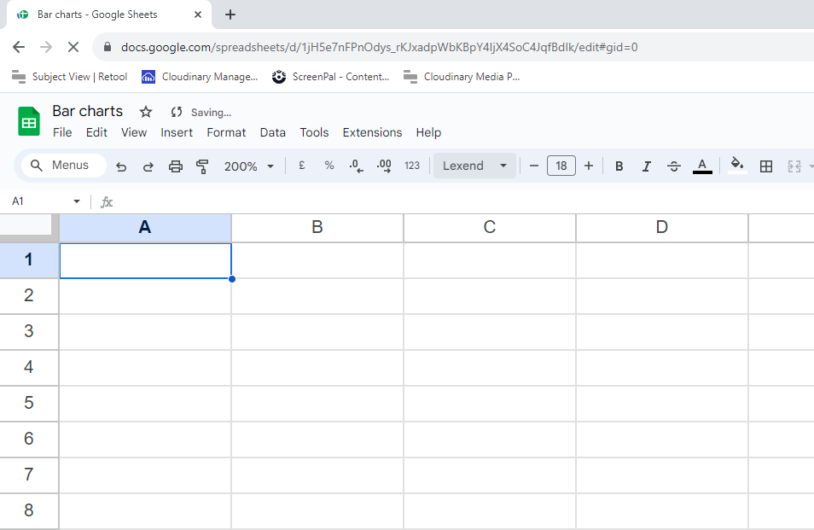
Creating bar charts on spreadsheet software
Google Sheets looks like this
Spreadsheet software has many functions and capabilities; this lesson is only focussing on its chart creation, specifically bar charts.
Left image: Google Sheets is a trademark of Google LLC and this content is not endorsed by or affiliated with Google in any way. Right image: Microsoft Excel - Used with permission from Microsoft.

Slide 8
Creating bar charts on spreadsheet software
One part of the data cycle is collecting and representing data.
Although this can be done by hand often investigations result in a large amount of data and using software allows this to be sorted and displayed very efficiently.
Most careers that collect, present and analyse data will use technology.

Slide 9
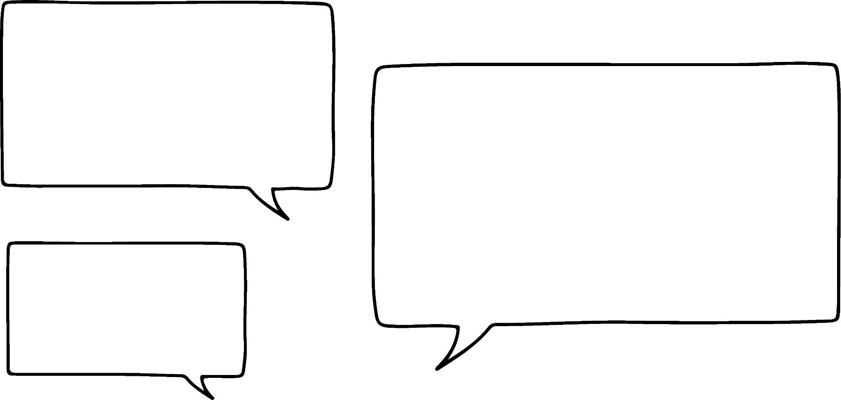

Creating bar charts on spreadsheet software
Data as a list can be copied and pasted into the spreadsheet.
You can use the keyboard shortcut ctrl + C and ctrl + V
Copy this list into your spreadsheet file.
red, blue, silver, white, red, red, white, white, black, yellow, silver, white, green, black, red, black, blue, grey, orange, grey, grey, red, white, black, black, silver, grey, blue, red, yellow
Laura
This saves typing each word separately which saves time. What other benefit is there to not typing each word?
Data entry error is avoided.

Slide 10
Creating bar charts on spreadsheet software
We’re going to paste the data and ensure it is in a column format.
Google Sheets is a trademark of Google LLC and this content is not endorsed by or affiliated with Google in any way.
Notes:
Find Data on the ribbon and and then ‘Split text to columns’
If you are working in MS Excel, it is very similar.
The software needs this to be a vertical list rather than a horizontal list.
On a different cell we are going to use the paste transposed option.
Find this under paste special.

Slide 11

Creating bar charts on spreadsheet software
Which direction does a list need to be for the spreadsheet to create a chart?
horizontal
vertical
it doesn’t matter

Slide 12
Creating bar charts on spreadsheet software
Once the data is in the spreadsheet, we can visualise it using charts.
Google Sheets is a trademark of Google LLC and this content is not endorsed by or affiliated with Google in any way.
Notes:
Click on ‘Chart’
For this data, Google Sheets recommends a pie chart.
Change the chart type to column chart.
The ‘bar chart’ runs horizontally whereas the ‘column chart’ is more like our standard bar chart.
In the customise tab, you can add and remove axis titles.
Add ‘frequency’ as your vertical axis title.

Slide 13

Creating bar charts on spreadsheet software
Order the steps for inserting a chart from a list of data.
3
Click ‘chart’.
1
Select all the data.
4
Change the chart type (if necessary).
2
Go to the ‘insert’ tab on the top ribbon.

Slide 14
Creating bar charts on spreadsheet software
Order the steps for inserting a chart from a list of data.
1
Select all the data.
2
Go to the ‘insert’ tab on the top ribbon.
3
Click ‘chart’.
4
Change the chart type (if necessary).

Slide 15
Creating bar charts on spreadsheet software
If your data is already in a frequency table, then you can copy the whole table onto the spreadsheet, or you can type it in.
Gym class | Frequency
Aerobics | 18
Circuits | 25
Spin | 16
Zumba | 42
Copy this table onto a new sheet in your spreadsheet.
The following steps use Google Sheets.

Slide 16
Creating bar charts on spreadsheet software
Follow these step to insert a bar chart using the frequency table
Google Sheets is a trademark of Google LLC and this content is not endorsed by or affiliated with Google in any way.

Slide 17
Creating bar charts on spreadsheet software
Another gym class is offered called ‘step’ and 16 members attend it. Let’s update the frequency table and check the bar chart
Google Sheets is a trademark of Google LLC and this content is not endorsed by or affiliated with Google in any way.
Notes:
The software you are using determines where you can add the new row to the table for the chart to update. Excel does not update the chart if a new row is added to the bottom

Slide 18
Creating bar charts on spreadsheet software
Here is some data for different books.
Book | Frequency
Book 1 | 79
Book 2 | 152
Book 3 | 203
Book 4 | 187
The auto scale was increments of 50.
What scale would you use?
20 or 25 might seem sensible.

Slide 19
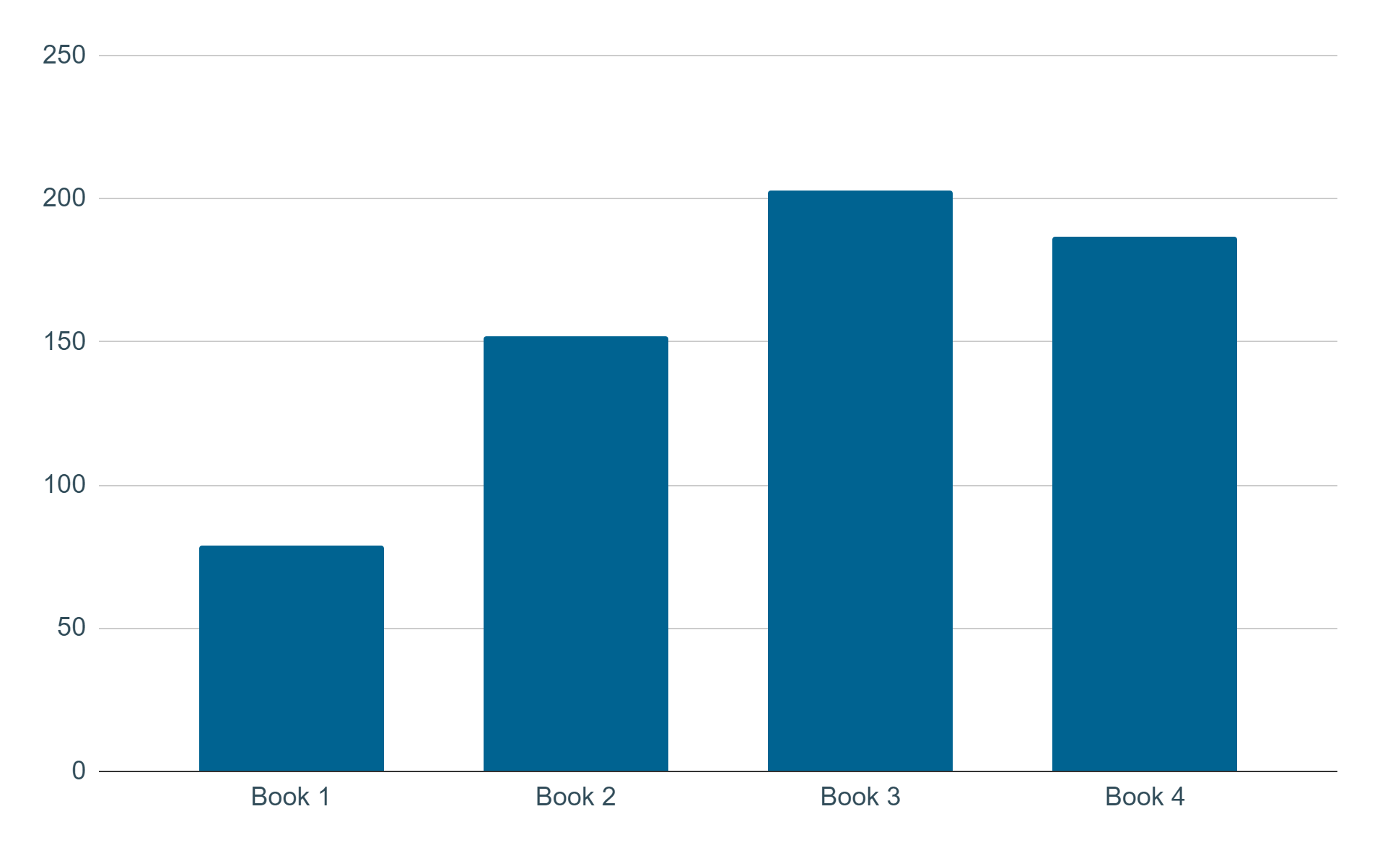

Creating bar charts on spreadsheet software
The spreadsheet software will detect the data and automatically choose multiples of 50 for the vertical axis.
Number of pages per book
This scale makes a lot of empty space.
Frequency
Izzy
Books
Google Sheets is a trademark of Google LLC and this content is not endorsed by or affiliated with Google in any way.

Slide 20
Creating bar charts on spreadsheet software
Let’s make the vertical axis go up in multiples of 25.
Google Sheets is a trademark of Google LLC and this content is not endorsed by or affiliated with Google in any way.
Notes:
Check you are on the vertical axis
In the Chart editor, go to the customise tab
Expand the ‘gridlines and ticks’ section
Check you are on the vertical axis
Both the major and minor spacing types have the option of step or count.
Step means what the scale should increase in.
Count means how many increments there should be.

Slide 21
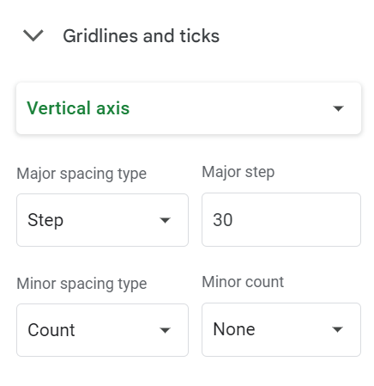
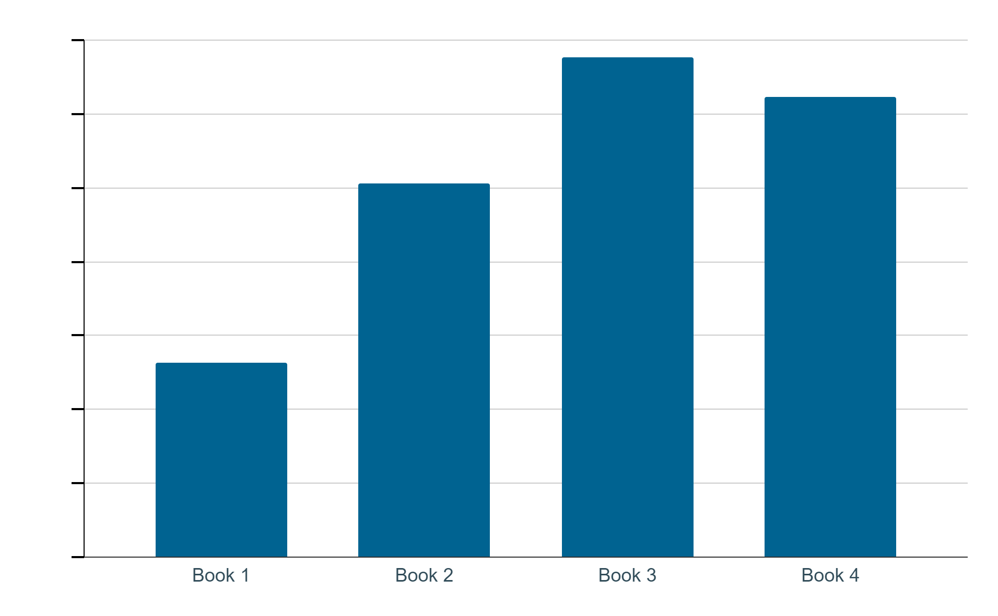
Creating bar charts on spreadsheet software
Add the vertical axis according to this setup.
210
180
Frequency
150
120
90
60
30
0
Books
Google Sheets is a trademark of Google LLC and this content is not endorsed by or affiliated with Google in any way.

Slide 22
Creating bar charts on spreadsheet software
The flower sales at a garden centre are recorded.
Create a bar chart for this list of data: rose, tulip, marigold, viola, rose, rose, marigold, viola, daffodil, tulip, daffodil, petunia, marigold, daffodil, rose, tulip, petunia, petunia, tulip, marigold, rose, viola, rose, petunia, viola, viola Ensure it has a title on both axes.
Would you advise the garden centre to order an equal amount of each flower next time or different amounts? Explain your answer.

Slide 23
Creating bar charts on spreadsheet software
Create a bar chart for this table of data about visitors to a museum.
Ensure it has titles on both axes.
Day of the week | Frequency
Monday | 28
Tuesday | 25
Wednesday | 32
Thursday | 27
Friday | 34

Slide 24
Creating bar charts on spreadsheet software
Create a bar chart for this table of data about visitors to a museum.
What is different about this bar chart?
Day of the week | Frequency (week 1) | Frequency (week 2)
Monday | 28 | 24
Tuesday | 25 | 23
Wednesday | 32 | 34
Thursday | 27 | 26
Friday | 34 | 32

Slide 25
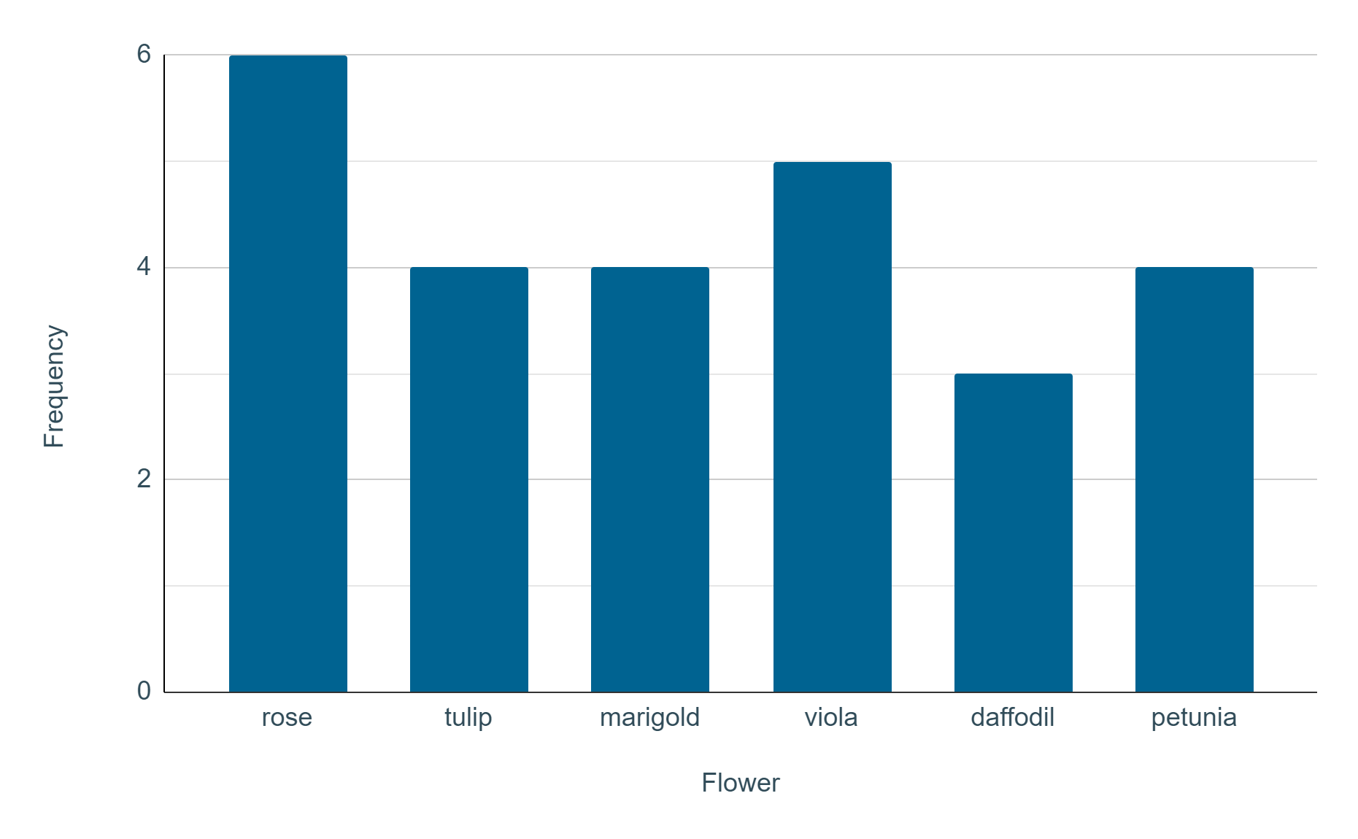
Creating bar charts on spreadsheet software
The flower sales at a garden centre are recorded.
Create a bar chart for this list of data:
It doesn’t matter if you have changed the colours or scales.
Google Sheets is a trademark of Google LLC and this content is not endorsed by or affiliated with Google in any way.

Slide 26
Creating bar charts on spreadsheet software
The flower sales at a garden centre are recorded.
Would you advise the garden centre to order an equal amount of each flower next time or different amounts? Explain your answer.
Your response may have included:
The total amount of sales is not very high, so although daffodil sales were the lowest on this particular day, it may not be the case on another day. The garden centre should collect further data to get a better understanding of the sales.

Slide 27
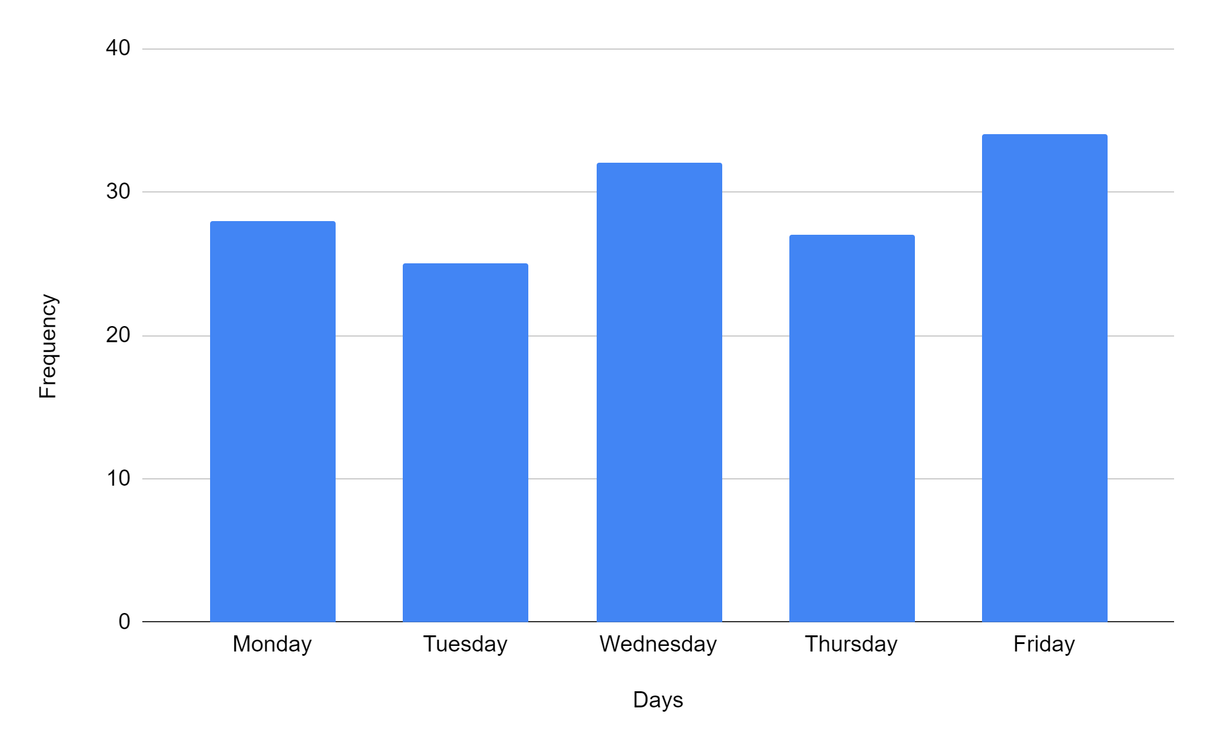
Creating bar charts on spreadsheet software
Create a bar chart for this table of data about visitors to a museum.
Day of the week | Frequency
Monday | 28
Tuesday | 25
Wednesday | 32
Thursday | 27
Friday | 34
Google Sheets is a trademark of Google LLC and this content is not endorsed by or affiliated with Google in any way.

Slide 28
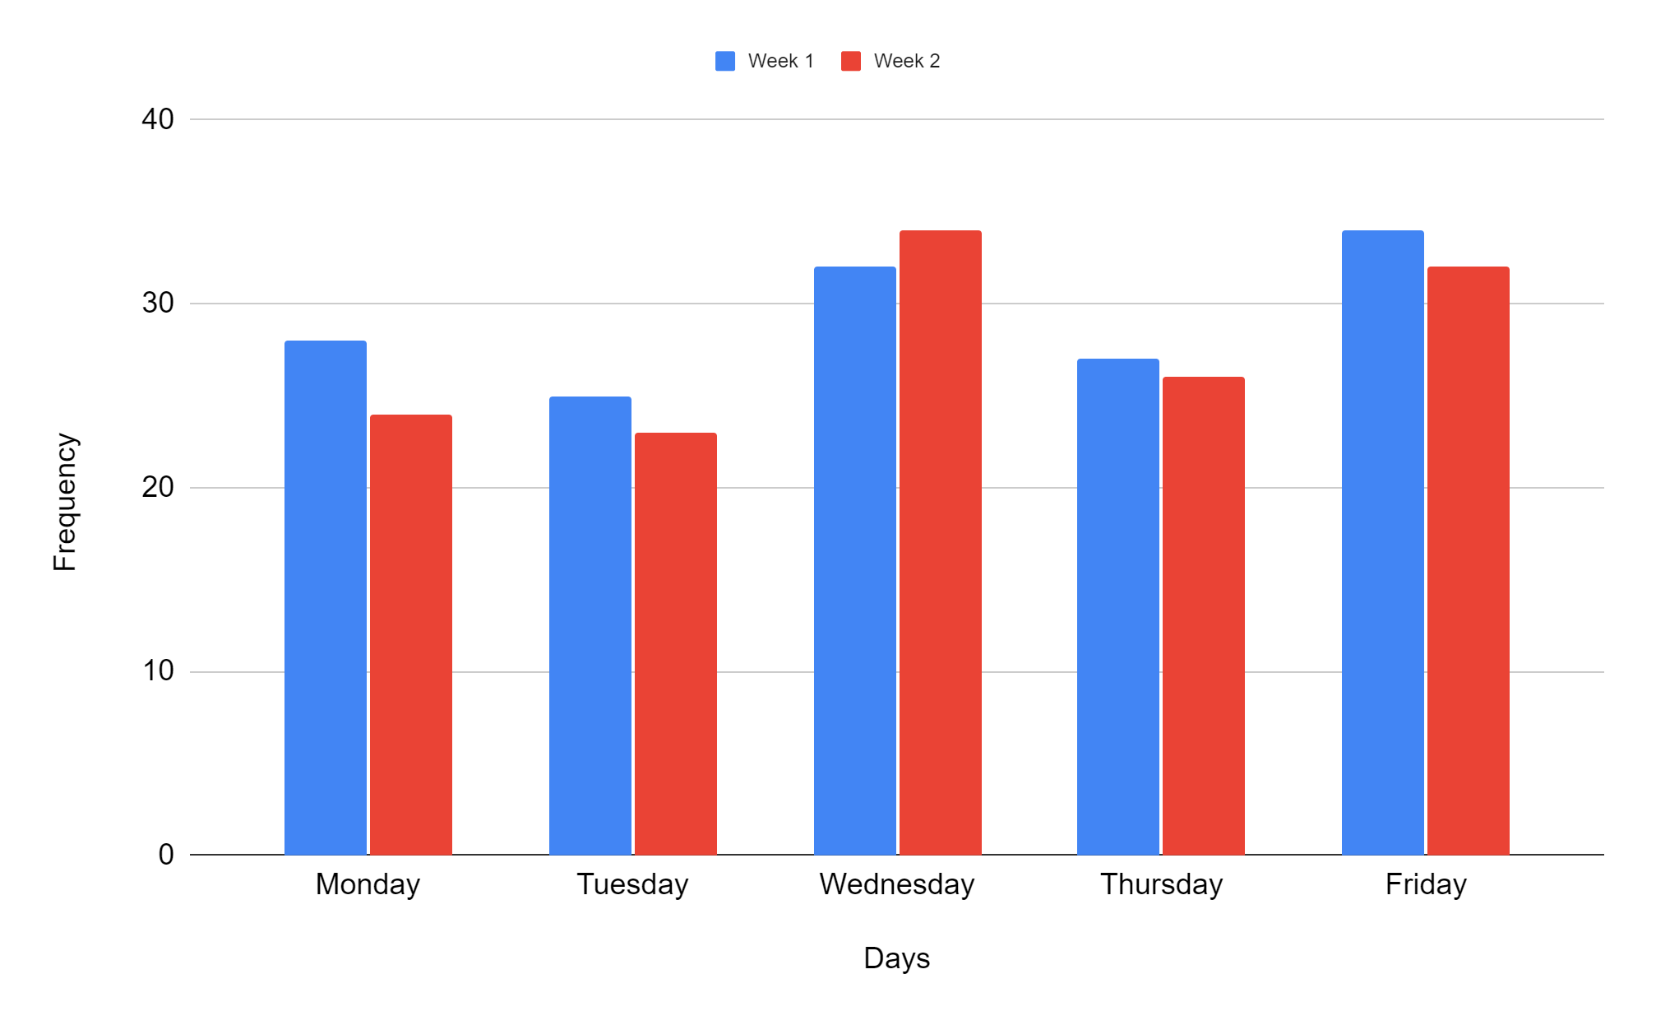
Creating bar charts on spreadsheet software
Create a bar chart for this table of data about visitors to a museum.
What is different about this bar chart?
It is a comparison bar chart, as there were two sets of data for the same thing.
Google Sheets is a trademark of Google LLC and this content is not endorsed by or affiliated with Google in any way.

Slide 29
Constructing bar charts by utilising technology
Creating bar charts on spreadsheet software
Creating bar charts using a template file

Slide 30
Creating bar charts using a template file
Creating bar charts is a fairly simple task on spreadsheet software.
The formatting and design can take a little longer.
Some individuals may need to create multiple charts.
Can you think of any individuals that might need to do that?
Scientific researcher
Someone making a presentation
Data analyst

Slide 31
Creating bar charts using a template file
To be more efficient, you can create a template file, to use over and over again.
Click Template file and save a copy.
You can rename it if you wish. Or it will save as Copy of Template file.

Slide 32
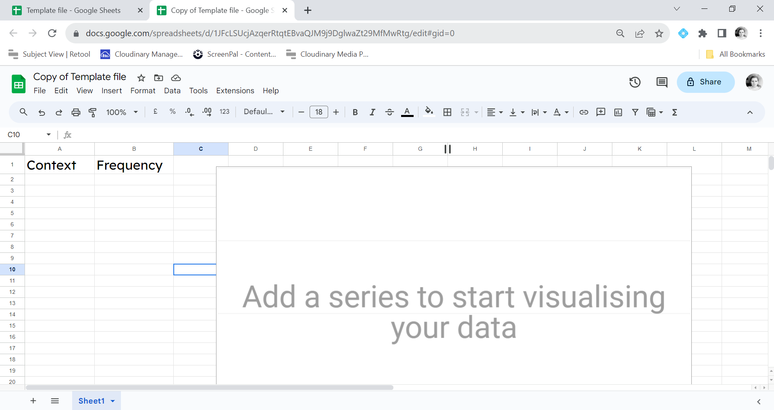
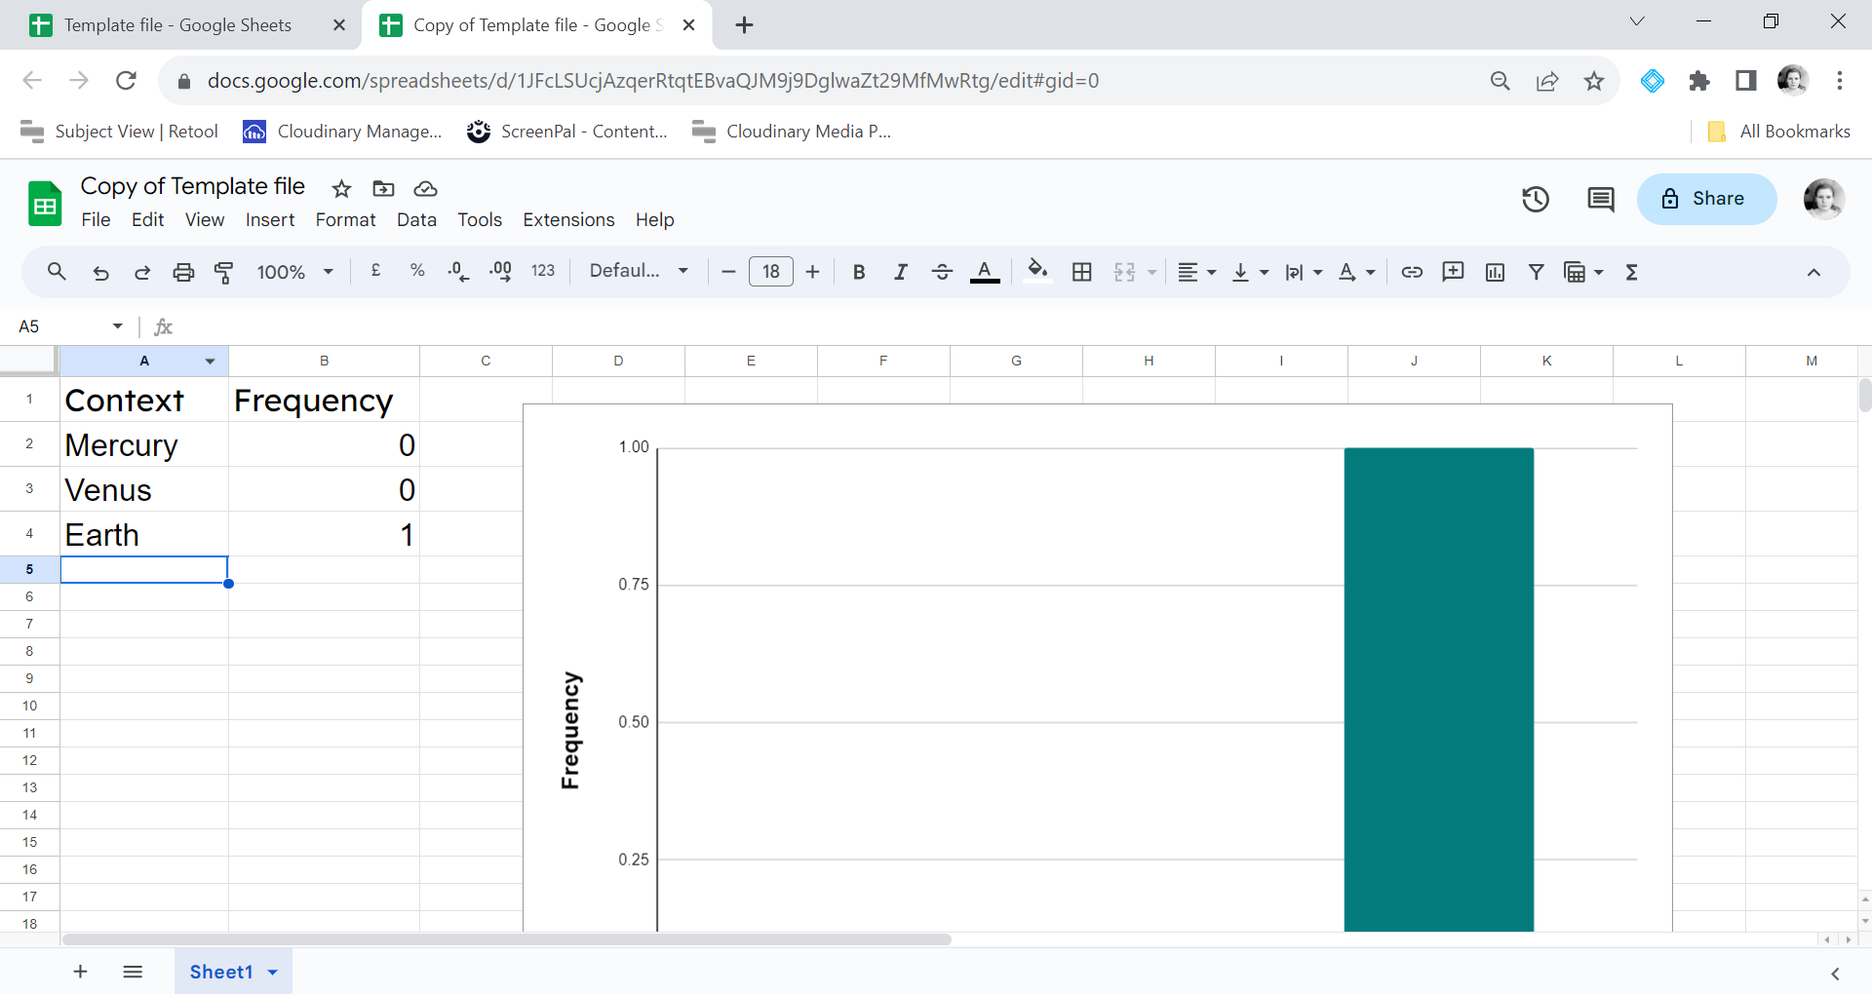
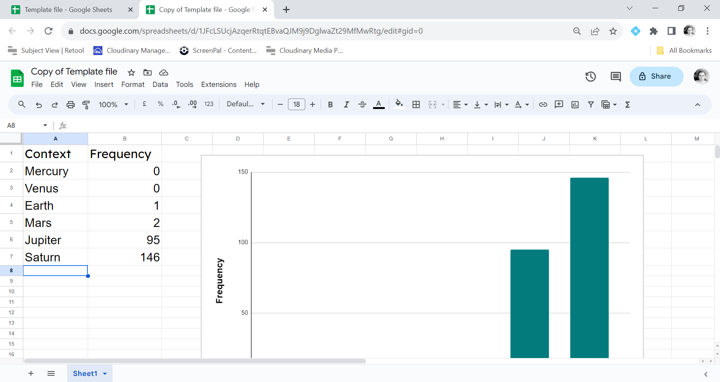
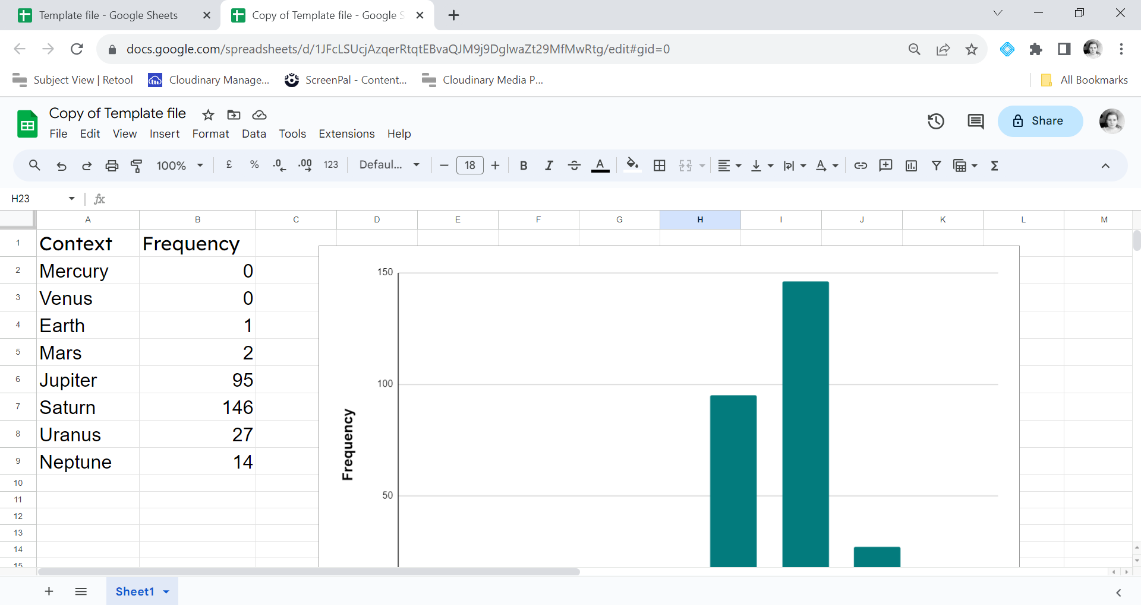
Creating bar charts using a template file
When you add data - a bar chart will appear.
Google Sheets is a trademark of Google LLC and this content is not endorsed by or affiliated with Google in any way.

Slide 33
Creating bar charts using a template file
When you add data, a bar chart will appear.
The context column is where you would type the different options e.g. if your colour is about colours then you might have red, blue, yellow, green etc.
The frequency column is where you would input the number of each option.
Give it a try for yourself.

Slide 34
Creating bar charts using a template file
Fill the blanks.
A
template file
is a useful tool when creating many bar
charts, where the style and formatting is to stay the same.

Slide 35
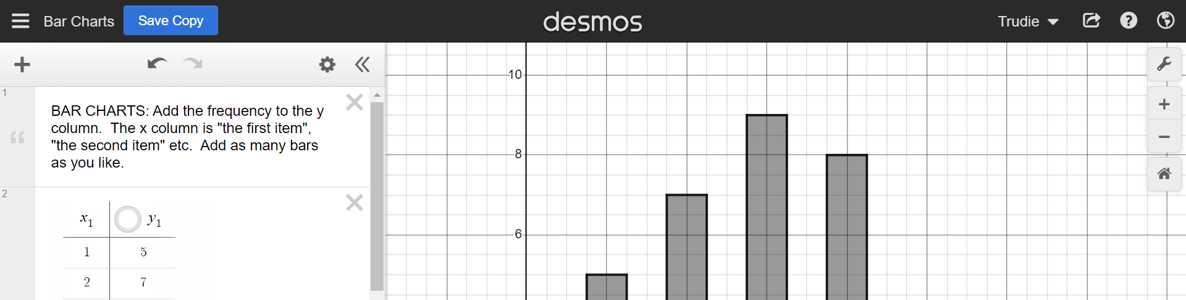
Creating bar charts using a template file
Other technology can also be utilised, even when it is not specifically spreadsheet software.
Click Desmos template

Slide 36
Creating bar charts using a template file
We can update the frequency table and the bar chart in our template.
Notes:
If you need additional bars, just type in the rows below.

Slide 37



Creating bar charts using a template file
On the desmos template file which icon duplicates?

Slide 38
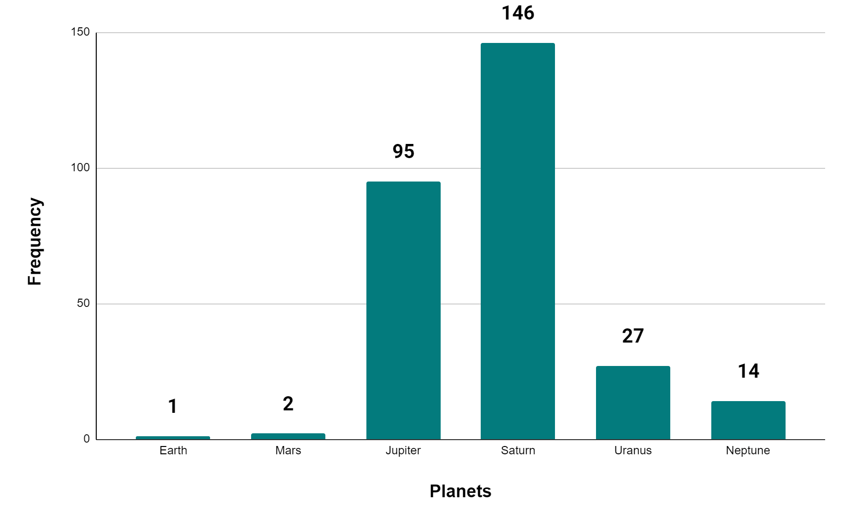
Creating bar charts using a template file
Using the template file recreate this bar chart, showing the number of moons per planet in our solar system.
Note: you do not need to add the numbers on the bars.
Google Sheets is a trademark of Google LLC and this content is not endorsed by or affiliated with Google in any way.

Slide 39
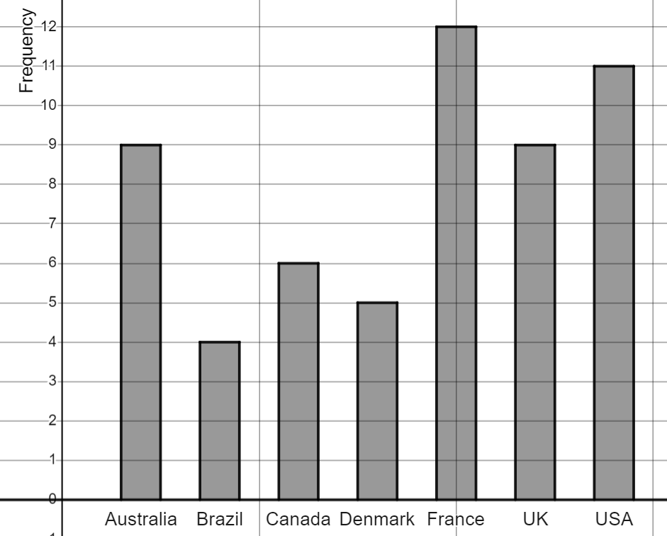
Creating bar charts using a template file
Task B Question 2 🖇 recreate this bar chart showing the number of time zones per country (including overseas territories).

Slide 40
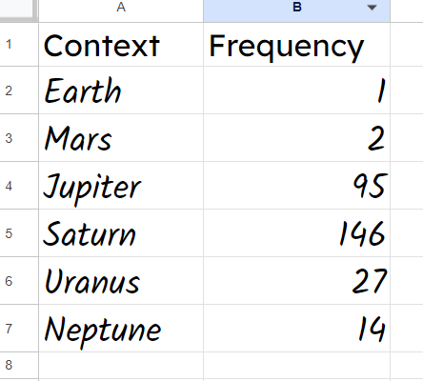
Creating bar charts using a template file
Using the template file recreate this bar chart.
The data should have been added like this.
Google Sheets is a trademark of Google LLC and this content is not endorsed by or affiliated with Google in any way.

Slide 41
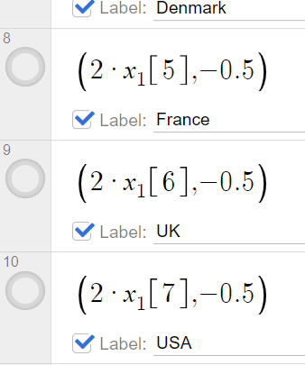
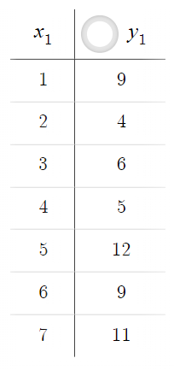
Creating bar charts using a template file
Task B Question 2 🖇 recreate this bar chart showing the number of time zones per country (including overseas territories).

Slide 42
Constructing bar charts by utilising technology
Many careers have a need to represent data, often multiple times. Technology is an efficient and useful tool to create bar charts.
Template files can be made and setup to assist with the creation of multiple bar charts that all have the same format and layout.

Slide 43

© Oak National Academy 2023.
Produced in partnership with Mathematics in Education and Industry.
Licensed on the Open Government Licence v3.0, except where otherwise stated. See Oak terms and conditions.

